Slide 1
Setting Up a New TypeScript Project, Demo SPFx
It’s easy to work with TypeScript when using a starter project or a tool like the Angular CLI, Create React App,… but what about a simple TypeScript project that would otherwise be just a vanilla JavaScript project? Let’s go over some simple ways to get started.

Slide 2
Dependencies
First, you need TypeScript installed of course. You can decide to have it installed globally on your machine, or locally to your project.
To install globally, run:
And to install locally, run:
npm i typescript -g
# or, using Yarn:
yarn global add typescript
npm i typescript –save-dev
# or, using Yarn:
yarn add typescript --dev

Slide 3
Setup
tsc is the TypeScript compiler and has a command line interface with plenty of available options.
To initialize a TypeScript project, simply use the --init flag:
If you’re using a version of TypeScript installed locally, you’ll instead want to ensure that you’re running the local version by calling tsc from the local node_modules folder:
Or, even better, simply using npx to ensure that the local version of tsc is used:
tsc --init
./node_modules/.bin/tsc --init
npx tsc --init

Slide 4
Setup …
After running tsc with the --init flag, a tsconfig.json will be added to your project folder with a few sensible defaults and an extensive list of commented-out possible configurations. Here are the starting configurations:
Let’s add just few more options to that base configuration:
{
"compilerOptions": {
"target": "es5",
"module": "commonjs",
"strict": true
}
}
With this, the JavaScript files that the TypeScript compiler outputs will be in a dist folder and sourcemaps will be generated.
{
"compilerOptions": {
……..,
“rootDir”: src,
"outDir": "dist",
"sourceMap": true
}
}

Slide 5
Compiling
With the tsconfig.json in place, we can start coding our app in TypeScript.
Let’s create an index.ts file in a src folder with few TypeScript code:
Compile with simply running tsc:
DEMO
Watch mode
Instead of running the TypeScript compiler every time you make a change, you can start the compiler in watch mode instead so that it recompiles every time there are changes to the TypeScript files:
tsc -w
tslint
Using a linter when coding is a must to quickly know about inconsistencies, syntax errors and omissions. The de facto linter for TypeScript is tslint. [------ May be will cover next time]

Slide 6
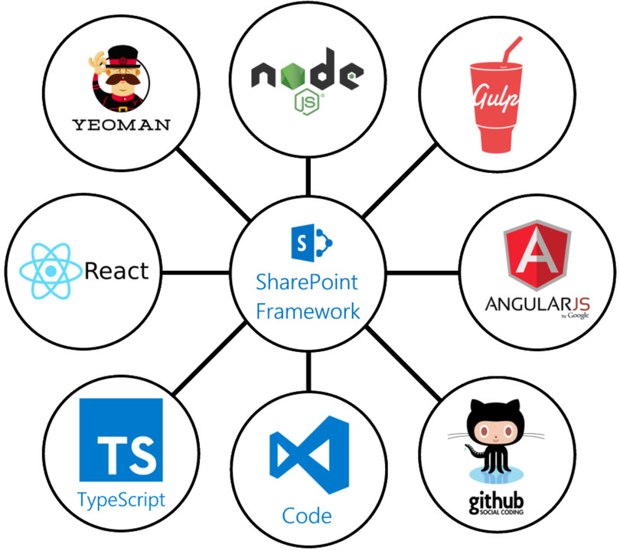
Using SPFx (SharePoint Framework)
Tools

Slide 7
Environment Setup for SPFx
NodeJS install version 10.x (Supported version is v8.x and v10.x)
Yeoman helps you kick-start new projects, and prescribes best practices and tools to help you stay productive. SharePoint client-side development tools include a Yeoman generator for creating new web parts. The generator provides common build tools, common boilerplate code, and a common playground website to host web parts for testing.
Gulp is an open-source JavaScript toolkit used as a streaming build system in front-end web development.
The Yeoman SharePoint web part generator helps you quickly create a SharePoint client-side solution project with the right toolchain and project structure.
npm install –g yo gulp
npm install –g @Microsoft/generator-sharepoint
#Once SP Clinent project is created run:
Gulp trust-dev-cert

Slide 8
Thank you
Tesfaye Gari
System and Application Architect @American Chemistry Council
Tesfaye.gari@gmail.com

